Slide 1

Hospitality Data Analysis Report
Report - Q2 - 2022
Atliq Hotel Chain

Slide 2
Introduction
Atliq Grands owns multiple five-star hotels across India. They have been in the hospitality
Industry for the past 20 years.
Due to strategic moves from other competitors and ineffective decision-making in management, Atliq Grands are losing its market share and revenue in the luxury/ business hotels category.
As a strategic move, the managing director of Atliq Grands wanted to incorporate “business and data intelligence” in order to regain their market share and revenue.

Slide 3
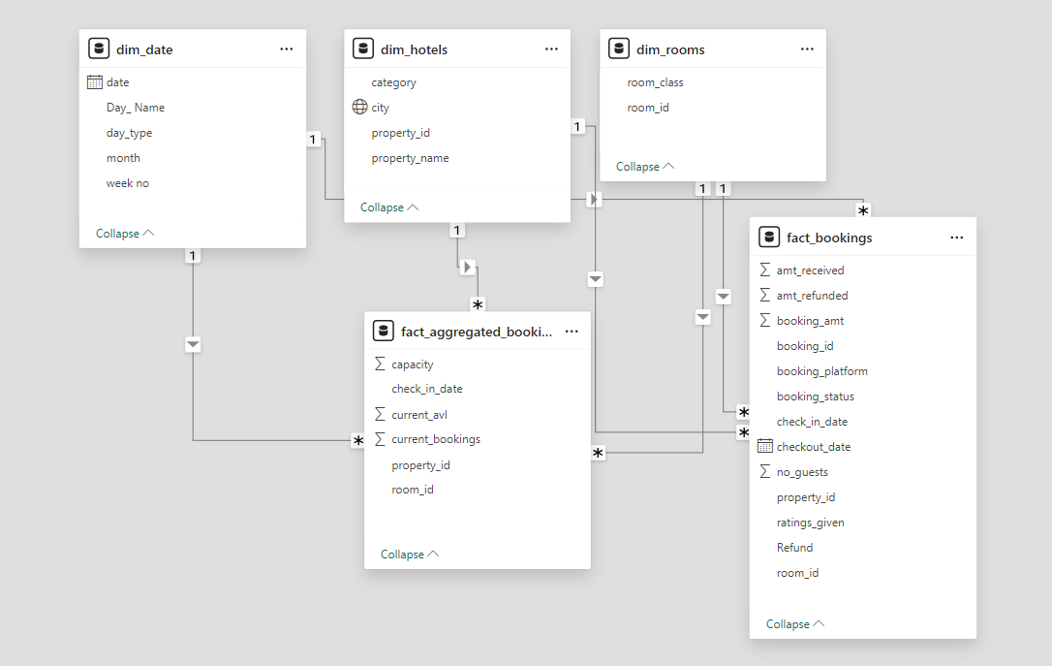
Dataset Information and Overview
The Dataset consists of 5 Tables.
dim_date – Dates, Months etc
dim_hotels – name, id, city, category
dim_rooms – room class, id
fact_bookings – Customer Booking data
fact_aggregated_bookings – Hotel Booking Data
The DIM tables have the dimensions and the FACT tables have the continuous data.
The data was imported to Power BI and the data model created is shown.
This data is used to generate insights and to uncover key findings.

Slide 4
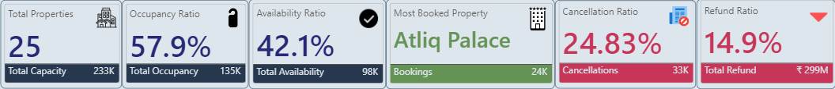
KPI Overview
This report presents a comprehensive analysis of the performance of the Atliq Hotel Chain during the second quarter of 2024 (April - June).
The data covers key metrics across 25 properties in major Indian cities.
Few KPIs include:
Total Bookings, Occupancy and Cancellations.
Capacity vs Availability Ratio.
Occupancy vs Cancellation Ratio.
Revenue Breakdown
Income vs refund analysis
Weekly and monthly trends
Average Ratings
Bookings by City, Day Type, Room Category

Slide 5
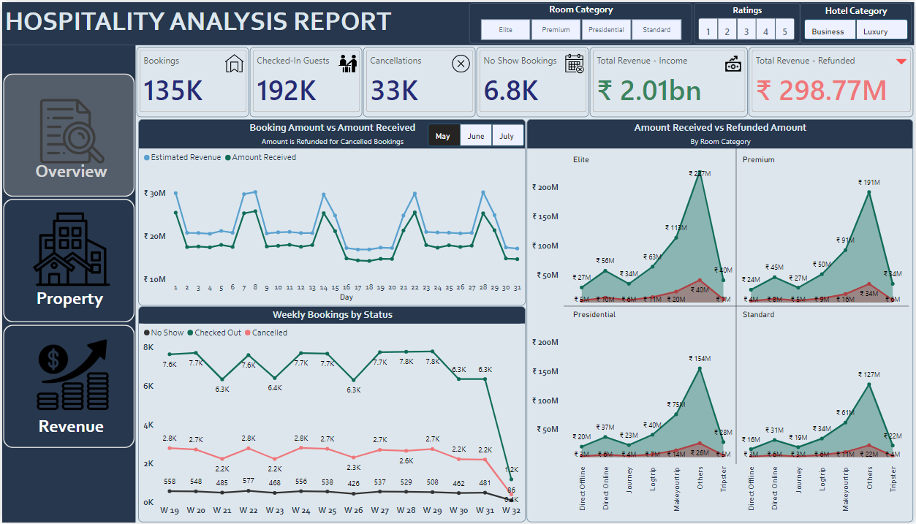
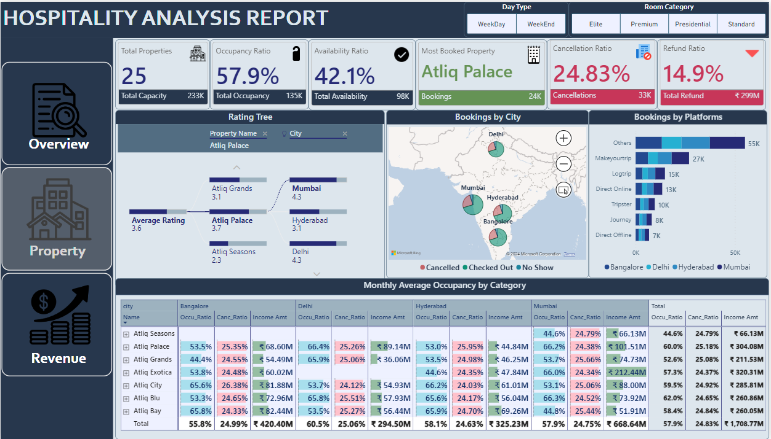
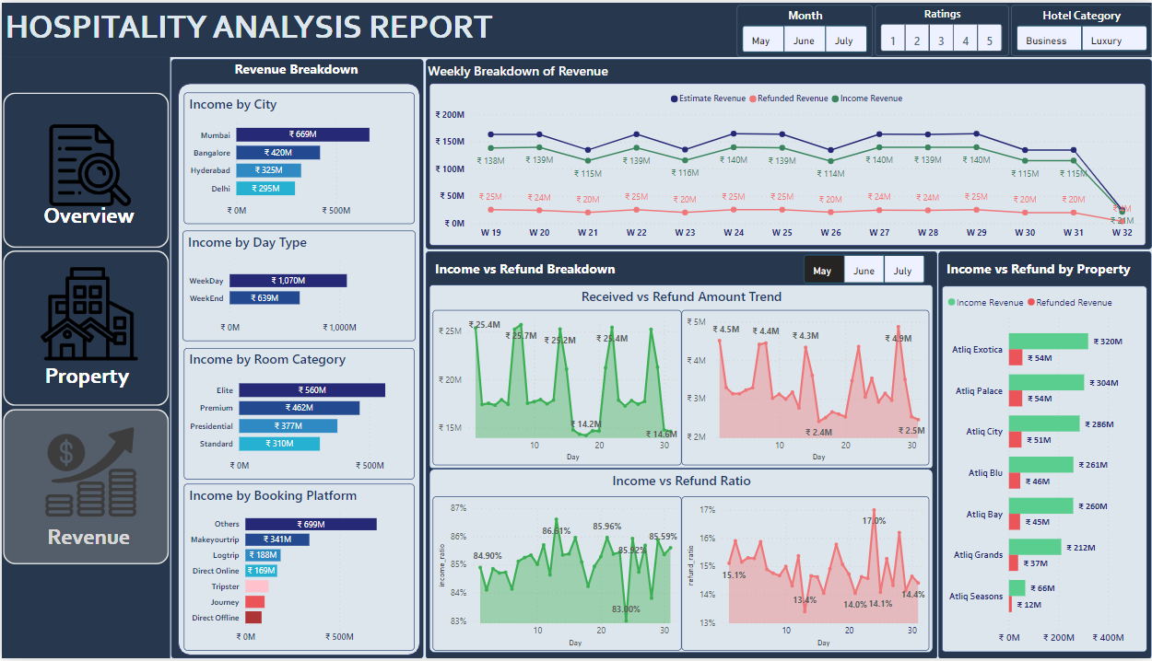
Dashboard Overview
The report is divided into 3 sections:
Overview – An overview of the revenue and bookings.
Property – Breakdown of Ratings, Bookings, Occupancy, etc.
Revenue – Revenue Breakdown by different factors, Refunds, Hotels, etc.

Slide 6
Key Findings
The hotel chain achieved solid revenue performance of ₹2.01 billion over the 3-month period, driven by premium room categories like Elite and Premium.
Online and mobile channels (Direct Online, Mobile App) were the dominant booking platforms, indicating effective digital presence.
High cancellation ratio of 24.83% and a refund ratio of 14.9%, impacting net revenue.
Occupancy levels varied significantly across cities, with Bangalore (66.6%) and Delhi (60.5%) outperforming Mumbai (52.6%).
The most booked and highest-rated property was Atliq Palace, suggesting strong brand reputation and customer satisfaction.
Weekly and monthly patterns showed booking and revenue peaks around the middle of each month, with refund ratios highest in the first week.
Income ratios (estimated revenue vs. received) were healthiest around the 85-90% range during peak booking periods.

Slide 7
Hospitality Data Analysis Report
THANK YOU

